Slide 1
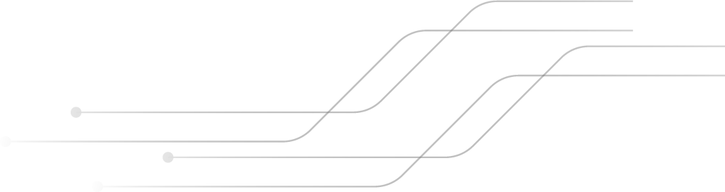
CALL DATA CENTRE DEMONSTRATION USING OSPF
MOHAMMED SHOAIB KHAN
(RA2011003011289)
NIPURN BHAAL
(RA2011003011272)
Department of Computing
3rd Year
SRM Institute of Science and Technology, Kattankulathur
KUMAR SHASHWAT
(RA2011003011262)
ARYAMAN ADIVYA SINGH
(RA2011003011266)

Slide 2


TABLE OF CONTENTS
01
02
03
INTRODUCTION
REQUIREMENTS AND ROUTING TABLE
DESIGN ANALYSIS
04
05
06
TESTING AND ANALYSIS
CONCLUSION
BIBLIOGRAPHY

Slide 3
Call Centre Data Transmission And Communication
01
ABSTRACT AND INTRODUCTION

Slide 4


ABSTRACT
This project briefly explains the concept of OSPF protocol and shows its
implementation with an use case scenario. Here the scenario is
communication and transmission of data, within the branches of a call
centre.
It also illustrates OSPF protocol’s benefits and possible (if any) issues.
The OSPF Protocol is a dynamic routing protocol which provides a highly
functional open protocol that any vendor can use to communicate using the
TCP/IP protocol family. It can converge the networks extremely fast and
ensures loop free paths.
It has features that allow for the stricter propagation of routes, for load
sharing, and for selective route importing. It can also provide better load
sharing on external links rather than other IGPs (Internal Gateway
Protocols).

Slide 5
INTRODUCTION
OSPF (Open Shortest Path First) Protocol is a famous TCP/IP Internal Gateway Protocol which is used to
distribute information within a single system. It is based on link-state technology which is different from algorithms like RIPv4 which are used in Internet Routing protocols.
OSPF Protocol has many new features, including:
- Variable Length Subnet Masks
- Route summarization
- Authentication of Routing Updates, etc.
- It uses IP multicast to send link-state updates. This ensures less
processing on routers that are not meant to listen to the packets. This
in only done in case of a change instead of doing it periodically This
helps in a better use of bandwidth
The traditionally used RIP has various limits in a large network setting
which have paved the way for OSPF.

Slide 6
Call Centre Data Transmission And Communication
02
Requirements and Routing Table

Slide 7
REQUIREMENTS AND ROUTING TABLE
OSPF Protocol has many new features, including:
- Variable Length Subnet Masks
- Route summarization
- Authentication of Routing Updates, etc.
- It uses IP multicast to send link-state updates. This ensures less processing on routers that are not meant to listen to the packets. This in only done in case of a change instead of doing it periodically. This helps in a better use of bandwidth
The traditionally used RIP has various limits in a large network setting which have paved the way for OSPF.

Slide 8
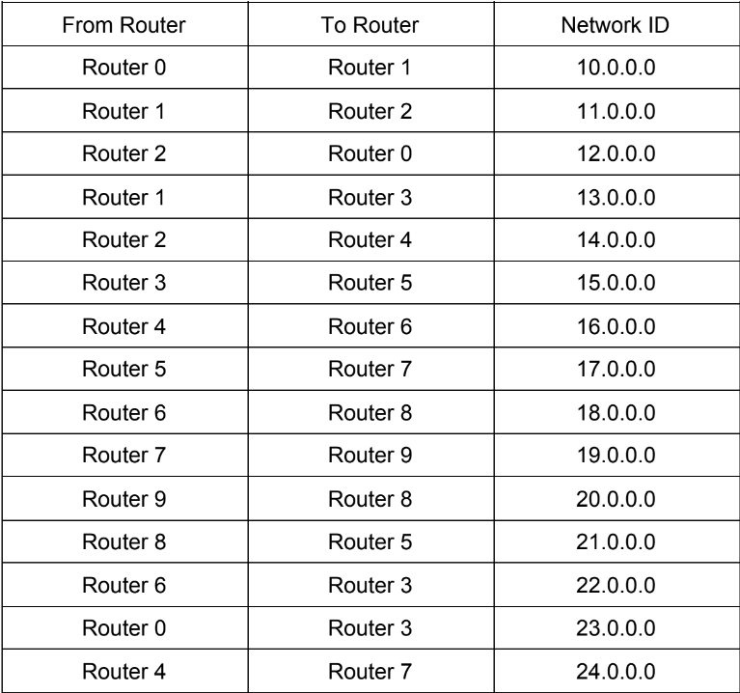
ROUTING TABLE

Slide 9
Call Centre Data Transmission And Communication
03
DESIGN ANALYSIS

Slide 10
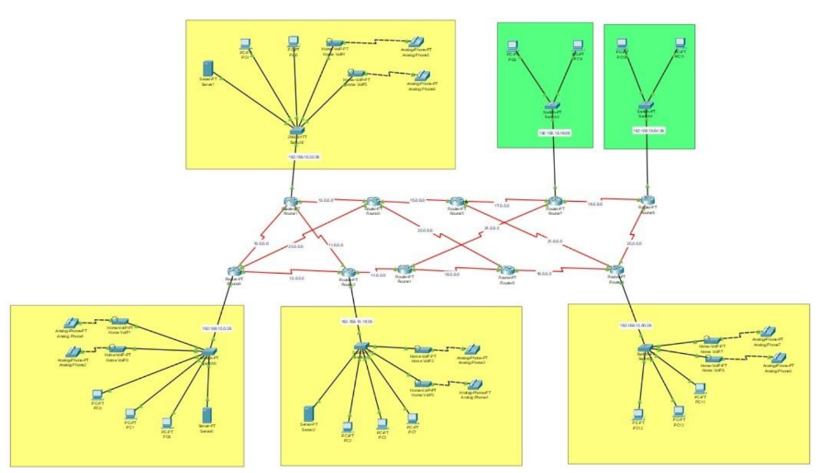

Slide 11
Call Centre Data Transmission And Communication
04
TESTING AND ANALYSIS

Slide 12
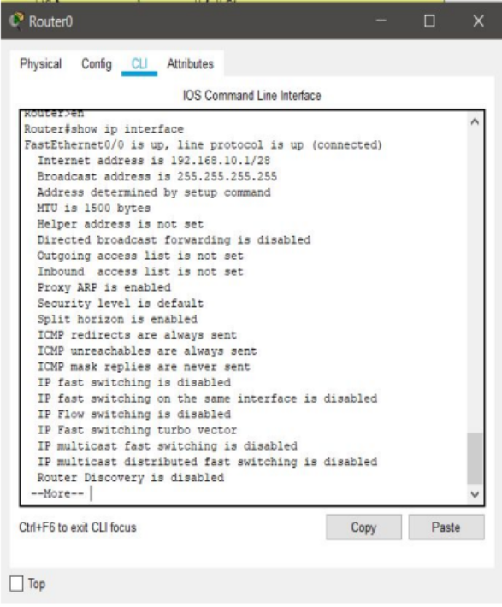
TESTING ANALYSIS
1.
The CLI of router 0 shows the internet address with the subnet mask and broadcast address.
Assignment of IP addresses is successful.

Slide 13
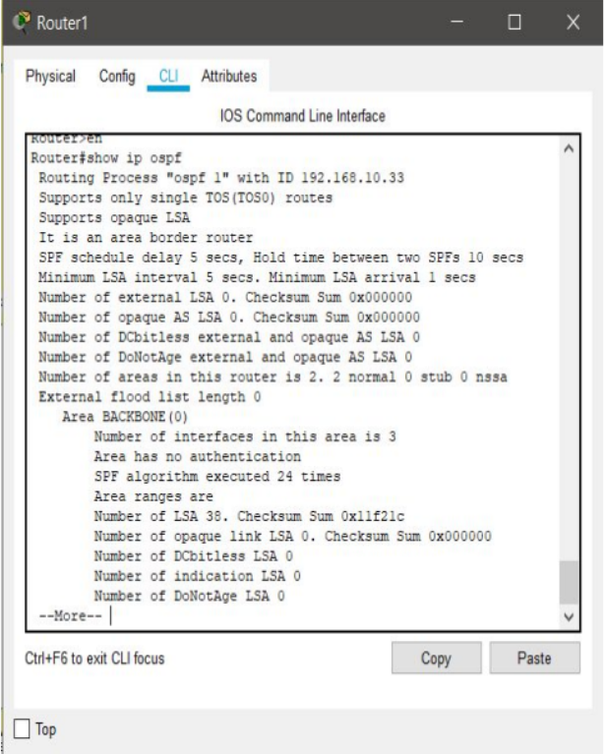
TESTING ANALYSIS
2.
The OSPF protocol successfully configured at router 1

Slide 14
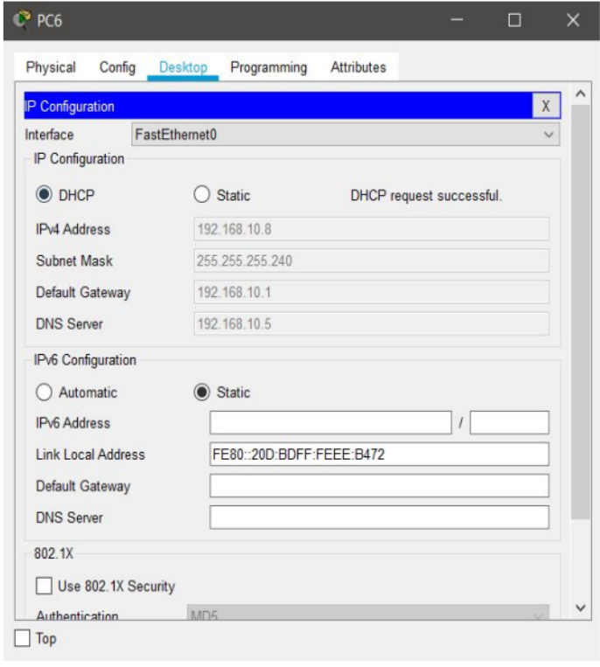
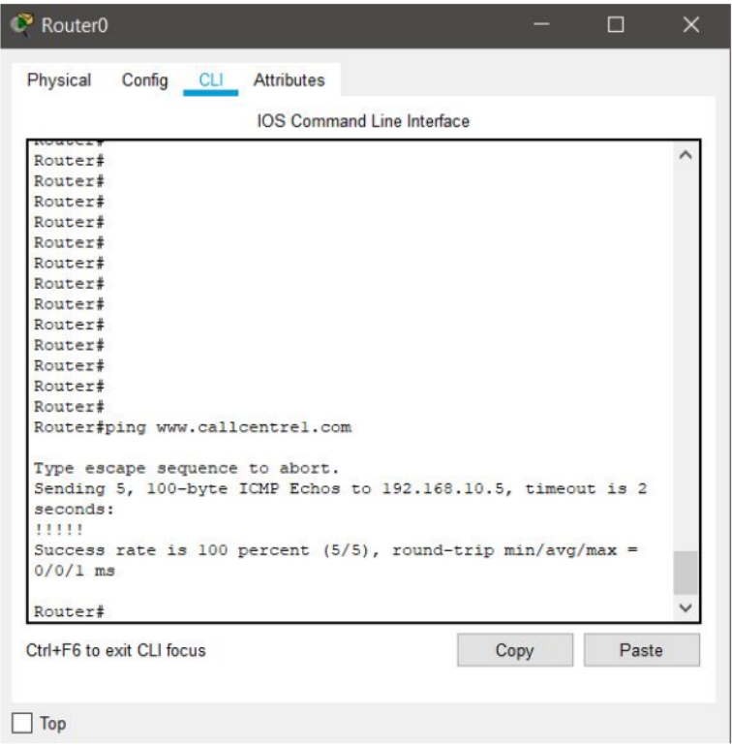
TESTING ANALYSIS
3.
Total addresses, IP address range, current index are show on CLI of router 0. Similarly we can check if the DHCP has been setup or not on other routers too. DHCP request on PC0 is successful.

Slide 15
TESTING ANALYSIS
4.
Shows the DNS server(192.168.10.5) at zone1 resolving host names into IP addresses.

Slide 16
TESTING ANALYSIS
5.
Shows the successful pinging of message packets from PC0(192.168.10.6) to PC2(192.168.10.22) and from PC6(192.168.10.8) to PC5(192.168.10.35)
Image attached in the next slide

Slide 17
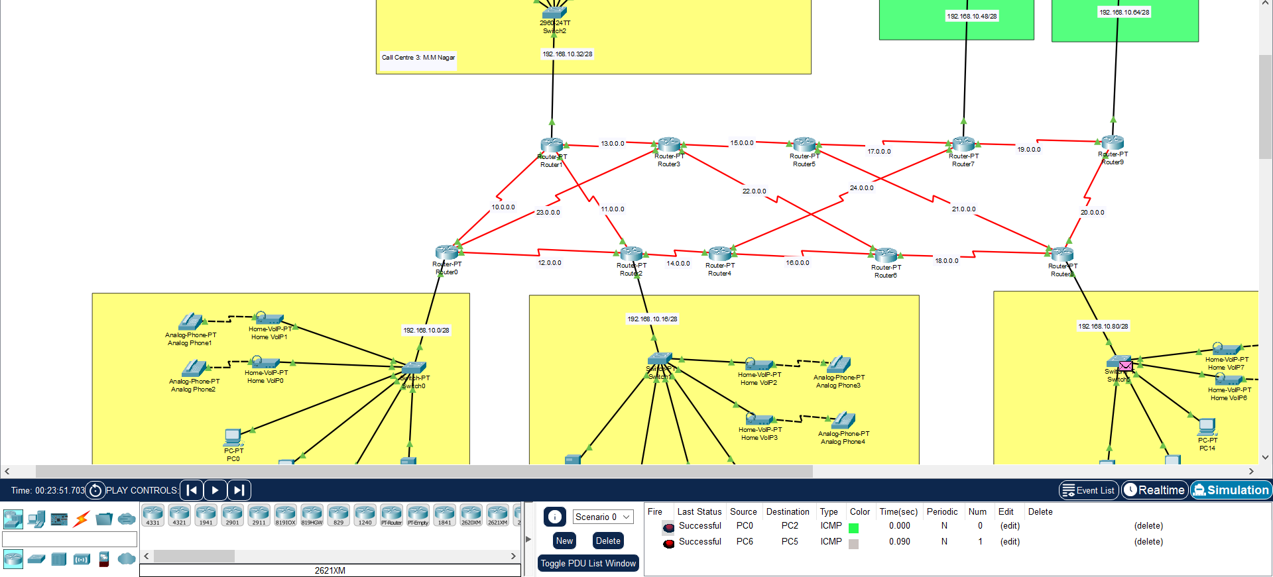
PREDICTED RESULTS

Slide 18
05
CONCLUSION
Multi LAN Fast Communication Network Topology is useful and can be implemented in call
centres where quick retrieval of data is needed in order to ensure quick responses to the
customers. As we have implemented OSPF Protocol, communication happens faster finding the shortest path for a message sent from a sender to travel and reach the receiver.
Future Enhancements:
❖ For future enhancement of this network scenario, we can implement VPN (Virtual
Private Network) tunnel between routers.Hence,when one call centre transfers data to
another,the data being transferred is always secure and in case of a breach the
location cannot be traced.
❖ 10 routers are available so the number of branches can be increased in order to
expand the area covered by the call centre.

Slide 19
FUTURE TASKS
Multi LAN Fast Communication Network Topology is useful and can be implemented in call
centres where quick retrieval of data is needed in order to ensure quick responses to the
customers.
Future Enhancements:
❖ For future enhancement of this network scenario, we can implement VPN (Virtual
Private Network) tunnel between routers.Hence,when one call centre transfers data to
another,the data being transferred is always secure and in case of a breach the
location cannot be traced.
❖ 10 routers are available so the number of branches can be increased in order to
expand the area covered by the call centre.

Slide 20
BIBLIOGRAPHY
06
https://www.netacad.com/courses/packet-tracer
https://www.cisco.com/c/en/us/td/docs/routers/access/800M/software/800MSCG/routconf.htm
Subnetting:
https://www.cisco.com/c/en/us/support/docs/ip/routing-information-protocol-rip/13788-3.html
OSPF Proctocol Configuration-
https://www.cisco.com/c/en/us/td/docs/ios-xml/ios/iproute_ospf/configuration/xe-16/iro-xe-16-book/iro-cfg.html

Slide 21
THANK YOU

